Slide 1

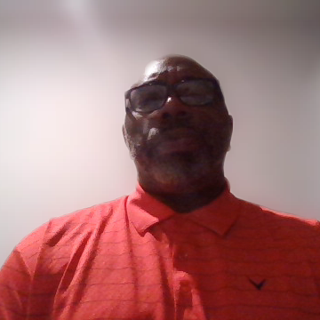
Notes:
This portfolio represents my transition from coaching into athletic administration. It reflects not only my experience, but also the growth I’ve made during my internship. I built it to show who I am as a leader, what I’ve learned, and where I’m headed in the sport management field.
The pieces that best showcase my growth are my experience with budgeting, the development of the girls’ flag football program, and my involvement in travel and operations. Budgeting was an area I was not as confident in at the beginning, but being part of those conversations helped me understand how decisions are made and how to manage resources. The flag football program stands out because it gave me hands-on experience building something from the ground up and thinking long term. Travel and operations helped me see the level of detail and planning that goes into keeping programs running smoothly behind the scenes.
Through this process, I learned that I am capable of making the transition from coach to administrator. My leadership and communication skills still apply, but I also understand that I need to continue growing in areas like budgeting and big-picture decision making.
This internship connects directly to my career goals. In the short term, I want to move into an Assistant Athletic Director or Director of Operations role. Long term, my goal is to become an Athletic Director at an HBCU and help build programs that are structured, competitive, and focused on student-athlete development.
If a potential employer views this portfolio, I want them to notice my growth, my willingness to learn, and the real experience I’ve gained. More than anything, I want them to see that I’m prepared to take the next step and continue developing as a leader in athletic administration.

